Slide 1
Silver State Health Insurance Exchange
Plan Year 2024
Plan Certification
April 25, 2023

Slide 2
Nevada State Based Exchange Notes
QHP/QDP binder submission are done through SERFF
QHP/QDP Approval/Certification for on exchange plans will be completed by the Exchange
QHP/QPD display on NevadaHealthLink.com
QHP/APTC/CSR eligibility is determined by the Federal guidelines
Medicaid/CHIP eligibility determined by State of Nevada DWSS
Issuer invoicing will be performed by SSHIX
This guidance summarizes policies proposed through other rulemaking processes that may not have yet been finalized, such as proposals included in the Notice of Benefit and Payment Parameters for 2023 not included in the final rule and the CMS 2023 Letter to Issuers. Stakeholders should refer to further rulemaking for finalized policies.

Slide 3
Calendar Year 2024 Issuer Fees
Fees for the calendar year 2024 will remain the same as the 2023 calendar year.
Carriers - Nevada Health Link - Official Website Nevada Health Link
Plan Type | Percent of Premium
Qualified Health Plan | 3.05%
Qualified Dental Plan | 3.05%

Slide 4
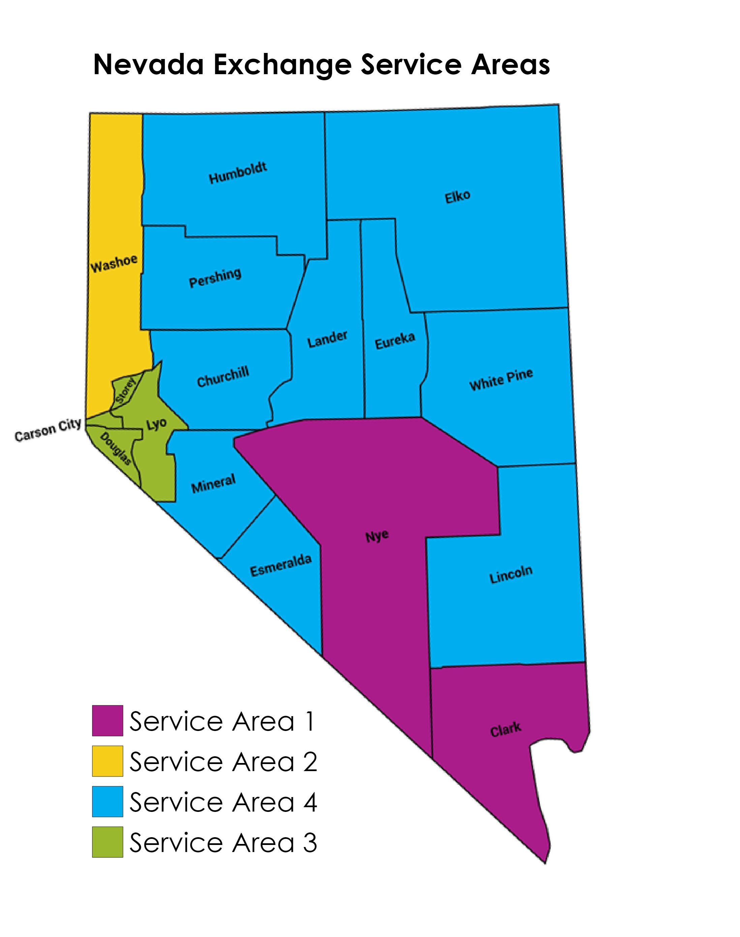
Exchange Service Areas
Nevada’s rating territories are aligned with Nevada’s on Exchange Service Areas
Nevada’s Service Areas for 2023 are unchanged
QHP and QDP service areas must equal one or more rating territories
On Exchange plans are not permitted to offer partial county coverage

Slide 5
Plan Year 2024 QHP Timeline
Activity | Deadline
Issuer submit Intent to EDI Test Form with SSHIX - Required | 4/3/2023
Issuers submit Intent to Sell Form with SSHIX – Required | 4/3/2023
CMS QHP Enrollee Survey data submission deadline | 5/19/2023
HHS-approved QHP Enrollee Survey vendor securely submits the QHP Enrollee Survey response data to CMS | 5/24/2023
Binder submission due in SERFF | 5/31/2023
SSHIX initial review of binder data submitted in SERFF | 5/31 - 7/13/2023
QHP issuer submits the validated QRS clinical measure data, with attestation, to CMS via NCQA’s Interactive Data Submission System (IDSS) | 6/15/2023
Initial objection letter sent | 6/16/2023
First data transfer from SERFF to Nevada Health Link SBE Platform | 7/13/2023
Issuer plan preview on Nevada Health Link SBE Platform | 7/13-8/19/2023
QHP issuers, Exchange administrators, and CMS preview the 2022 QHP quality rating information | 8/1-9/30/2023
Proposed rate change posted on the DOI website | 7/31/2023
Supplemental URL Templates due in SERFF | 8/3/2023

Slide 6
Plan Year 2024 QHP Timeline (cont.)
Activity | Deadline
Draft Plan Year 2023 Issuer Agreements sent to issuers for review | 8/16/2023
Plan Preview ends, deadline for all plans to be verified | 8/19/2023
Letters of Good Standing and Network Adequacy submitted to the Exchange from DOI | 8/19/2023
Final deadline for issuers to change QHP application without State Authorization (not applicable to rates) | 8/24/2023
Rate filings approved by DOI | 8/25/2023
Final data transfer from SERFF to Nevada Health Link SBE Platform if applicable | 8/28/2023
Plans re verified for rates – rates must be approved by DOI | 8/30/2023
Final Plan Year 2024 Issuer Agreements sent to issuers with final plan confirmation list | 9/4/2023
Issuers send signed agreements and confirm final plan listings | 9/4-9/13/2023
SSHIX to send final plan confirmation list and countersigned Issuer Agreements to issuers | 9/13/2023
Plans Certified in SERFF | 9/13/2023
Approved rate changes posted on the DOI website | 10/1/2023

Slide 7
Plan Year 2024 QHP Timeline (cont.)
Activity | Deadline
Consumer Window Shopping begins | 10/1/2023
URL links need to be live for Window Shopping | 10/1/2023
Limited data correction window (not applicable to utilize for service area changes, plan offerings, or rate data). Must obtain State Authorization prior to use of window | 10/5-10/9/2023
Anticipated public display of QHP quality rating information | 11/1/2023
Open enrollment begins | 11/1/2023
***Carriers will have the opportunity to make changes to their QHP applications from 8/24/23-10/31/23 WITH the approval from SSHIX and DOI. NO CHANGES WILL BE ACCEPTED PAST THE 10/31/23 DATE. ***

Slide 8
Electronic Data Interchange (EDI) Requirements for QHP’s and QDP’s
Any issuer intending to sell plans in Nevada for PY2024 must complete requirements with EDI testing prior to certification. Issuers will be required to notify SSHIX no later than April 3, 2023, if they intend to EDI Test with Nevada for PY2024. SSHIX will provide further guidance on EDI testing through the technical EDI discussions with issuers. New issuers will be required to work collaboratively with SSHIX and SSHIX’s vendor GetInsured (GI) for EDI related matters. For questions regarding EDI matters, please email the Recon Support team at: reconsupport@exchange.nv.gov.

Slide 9
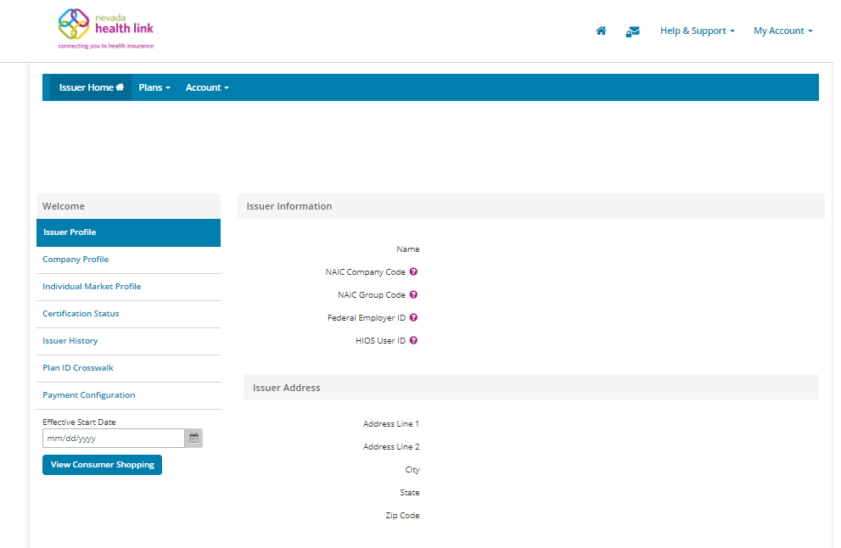
Issuer Representative
The Issuer Representative will be the issuers primary point of contact for non-technical QHP and QDP issuers related to the Exchange.
This assigned person will have access to verify plan data, add other designated staff with the Issuer Representative role access, and update issuer information such as: Issuer logo, URL’s, and phone numbers.

Slide 10
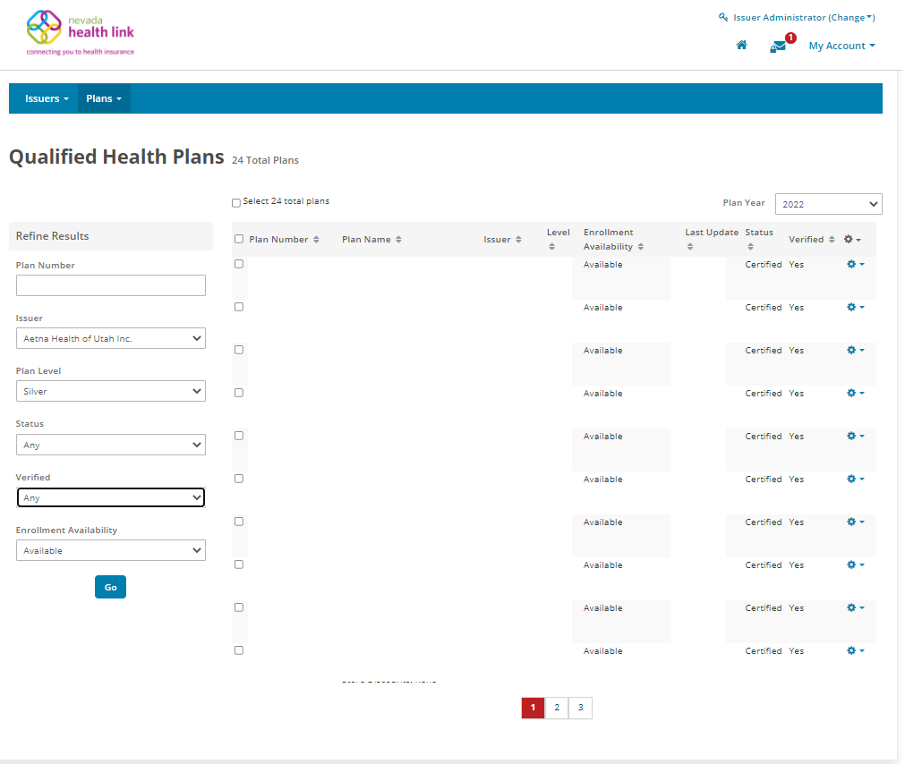
Issuer Representative

Slide 11
Application Review Tools
Issuers will still use all the applicable tools provided by CMS to identify and resolve data errors prior to each submission.
Issuers with data errors post-data lockdown that could have been identified and fixed through use of CMS tools incur the risk of not being certified.
Download the toolkit at:
https://www.qhpcertification.cms.gov/s/Review%20Tools
List of tools
Data Integrity Tool
Plan Crosswalk Tool
Master Review Tool
Essential Community Provider Tool
QDP Essential Community Providers Tool
Cost Sharing Tool
Drug Count Tool
Formulary Review Tool
Non-Discrimination Cost Sharing Review Tool

Slide 12
Required Templates – QHP Issuers
ECP/Network Adequacy Template (XML uploaded in .zip file)
Plans and Benefits Template (and Add-in file) (both XLS and XLM)
Prescription Drug Formulary Template
Network Template
Service Area Template (both XLS and XLM)
Rates Table Template
Business Rules Template
Crosswalk Template in .xlsm format is required on the supporting documents tab
Unified Rate Review Template
Supplemental URL Templates (Provided by SSHIX). Templates can be found on the Carriers - Nevada Health Link - Official Website Nevada Health Link
Accreditation certification and supporting documentation*
*refer to Accreditation slide for more information
Templates available for download: https://www.qhpcertification.cms.gov/s/QHP
Note: All templates must be validated and submitted within a SERFF binder. Issuers MUST run CMS tools prior to template submission.

Slide 13
URL Supplemental Templates
Key Changes for PY24: You are no longer required to submit a Transparency in Coverage Template before you submit a Transparency in Coverage URL. Once the SSM is open, you can submit Transparency in Coverage URLs with or without the template.
SSHIX has created the following Supplemental URL Templates to collect URL data from all issuers:
Plans and Benefits URL Supplemental Template
*Please provide the URL links for ZCS and Limited Cost Share AI/AN SBC’s on the Plans and Benefits URL Supplemental Template
Network URL Supplemental Template (please ensure these are correct and up to date)
Prescription Drug URL Supplemental Template
Supplemental Templates can be found on the SSHIX issuer webpage, linked here: Carriers - Nevada Health Link - Official Website Nevada Health Link
The Enrollment Payment URL is updated manually. If any issuers have changes to their Enrollment Payment URL, please email Plan Management at pmanagement@exchange.nv.gov

Slide 14
QHP Naming Conventions
•CarrierName_YYYYQ#mkt_v#_Template.xml
–Carrier Name: Up to 6 Characters which identify the carrier
–YYYY: four digit plan year
–Q#: “Q” followed by the quarter number, “1” for annual and “3” for small group quarterly filings
–mkt: “i” for individual “s” for small group filings
–v#: v followed by the version number (increment for each update to the filing)
–Template: indicate one of the following: NVT, RT, URRT, PBT, SAT
•NVT – Nevada Rate Filing Template
•RT – Federal Rates Template
•URRT - URR Template
•PBT - Plan and Benefit Template
•SAT - Service Area Template

Slide 15
Application Tips and Hints
Plans and Benefits Template
Each product should be its own benefit package in the template.
QHP/Non-QHP – must select both because of guaranteed availability.
For Plan Attributes, if there is a “yes” in “specialist requiring a referral,” the next field should also be populated, most of the time with “ALL.”
Individual plan’s expiration date: Should always be 12/31/20XX. (Not applicable to SHOP). This is required by the Exchange to be completed.
*Note-URL’s are no longer on the Plans and Benefits Template. Please submit the required Supplemental Plans and Benefits URL Template for the SBC and Plan Brochure URL’s.

Slide 16
Application Tips and Hints (cont.)
Plans and Benefits Template (cont.)
On the cost sharing tab of the template, verify the following do not apply for silver plans:
  Deductible does not increase as actuarial values increase.
  MOOP does not increase as the actuarial values increase.
  Cost sharing for all benefits does not increase as the actuarial values increase.
On the cost sharing tab of the template, verify the following do not apply for any cost sharing plan variations:
  You have listed a non-zero cost sharing for an essential health benefit.
  The zero cost sharing plan has values of zero for deductible and MOOP.

Slide 17
Application Tips and Hints (cont.)
Plans and Benefits Template (cont.)
Key Changes for PY24
Proposed de minimis ranges beginning in PY2023 are +2/−2 percentage points for all individual and small group market plans subject to the AV requirements under the EHB package, other than for expanded bronze plans, for which HHS proposes a de minimis range of +5/−2. Individual market silver QHPs have a proposed de minimis range of +2/0 percentage points and a de minimis range of +1/0 percentage points is proposed for income-based silver CSR plan variations.
A new section details the benefits mapping between the Plans & Benefits template and the benefits in the SBC Template for the URL review. Ensure consistency between the cost sharing values in the Plans & Benefits Template and SBC Template for these benefits.

Slide 18
Application Tips and Hints (cont.)
Plan ID Crosswalk Template
All issuers who offered 2023 coverage must submit a Plan ID Crosswalk template for plan year 2024.
Include all plans that were offered on the Marketplace in 2023 , including those that were suppressed following open enrollment if they received enrollees. Don’t include plans that were withdrawn prior to certification.
Follow DOI guidance for file naming conventions.
When entering the Reason for Crosswalk, only select the “Discontinuing Product” reason if you are not offering any plans in that product in any counties for the 2024 plan year.
Submit as “Supporting Documentation” within binder
    *Add both the XLSM and XML versions of the crosswalk to the SERFF binder as well

Slide 19
Application Tips and Hints (cont.)
Business Rules Template:
Requires minimum relations between primary and dependent:
Spouse-no, Foster Child-no, Ward-no, Stepson or Stepdaughter-no, Life Partner-no, Self-yes, Child-no, Other Relationship-no*
*Other Relationship is required when offering SHOP plans, and if also selling individual plans it must be added because the relationships have to be identical*
Note: On Child-only plans to allow sibling relationships to be listed on the same plan sibling relationships must be selected.

Slide 20
Standardized Plans
Standardized plan designs (now called Simple Choice Plans) are optional, and not required for PY2024.
The 2023 NBPP notes that standardized plans to be offered at every product network type, metal level, and throughout every service area that they offer non-standardized options in plan year (PY) 2023.
proposing to require issuers to offer standardized plan options at product network types, metal levels, and throughout services areas in which they do not offer non-standardized options. CMS has designed two sets of standardized plan options at each of the bronze, expanded bronze, silver, silver cost-sharing reduction (CSR) variations, gold, and platinum metal levels of coverage, with each set being tailored to the unique cost-sharing laws in different sets of states.
Issuers have the option to offer standardized plans at one metal level of coverage and not the others, unless it is silver then must have standardized silver cost-sharing levels.
“Set 1” would be utilized for Nevada.
Standardized plans will not be given differential display on the Nevada Health Link SBE Platform.

Slide 21
2024 Nevada EHB Benchmark Plan
•HPN Solutions HMO Platinum 15/0/90% (no change from PY 2023)
•Plan includes embedded pediatric dental and vision consistent with NV CHIP and FEDVIP, respectively
•45 CFR 156.115 prevents combined limits for rehabilitation and habilitation services
•Rehabilitation Services
–120 visits per year, no combined limit with Habilitation Services
•Habilitation Services
–120 visits per year, no combined limit with Rehabilitation Services

Slide 22
Presumptively Discriminatory Benefit Design
•2023 Payment Notice
•No discriminatory benefit design regardless of inclusion in statute or benchmark plan
–Benefit exclusions that are not clinically based, examples include:
•No age restrictions for autism spectrum disorder
•No age restrictions for infertility treatment

Slide 23
Accreditation
Accreditation
Accreditation is a requirement for QHP issuers, it does not apply to QDP issuers.
QHP issuers will submit their Accreditation certificate and supporting documentation through SERFF supporting documents tab.
If an issuer is entering its initial year of QHP certification, it must schedule (or plan to schedule) a review with a recognized accrediting entity (i.e., AAAHC, NCQA, or URAC).
An issuer is not required to be accredited in its initial year of QHP certification.
QHP issuers in their second or later year of certification must be accredited.
Please see Accreditation (cms.gov) for more information.

Slide 24
Accreditation cont.
Accreditation
SSHIX will consider issuers in their first, second or third year accredited with the following statuses:
- AAAHC with “Accredited” status
- NCQA with “Excellent,” “Commendable,” “Accredited,”
“Provisional,” or “Interim” status
- URAC with “Full,” “Provisional,” or “Conditional” status
SSHIX will consider issuers in their fourth year accredited with the following statuses:
- AAAHC with “Accredited” status
- NCQA with Marketplace accreditation and “Excellent,”
“Commendable,” “Accredited,” or “Provisional” status
- URAC with Marketplace accreditation and “Full” or
“Conditional” status

Slide 25
Indian Health Care Providers Addendum
Issuers are required to offer contracts in good faith to Indian Health Care Providers.
There are some provisions pertaining to Indian Health Care Providers that are not applicable to regular QHP/Network Provider agreements.
These provisions are addressed in the document called “Model QHP Addendum for Indian Health Care Providers,” which can be found here: Carriers - Nevada Health Link - Official Website Nevada Health Link
Issuers who do contract with Indian Health Care Providers must sign the Addendum. The Indian Health Care Provider must also sign.
The terms in the Addendum will supersede terms in regular QHP/Network Provider contracts.
SSHIX will require issuers to provide a statement that good faith contracts have been offered to all applicable Indian Health Care Providers.

Slide 26
Quality Reporting Strategy (QRS)
All qualifying issuers offering a QHP of any metal level through SSHIX must comply with QRS requirements and report on all quality measures defined by CMS
A qualifying issuer is an issuer that:
Offered through the Exchange in the prior year (i.e., 2021 calendar year);
Offered through the Exchange in the ratings year (i.e., 2022 calendar year) as the exact same product type; and
Meets the QRS minimum enrollment requirements:
- Included more than 500 enrollees as of July 1 in the prior year (i.e., July 1,2022, and
- Included more than 500 enrollees as of January 1 of the ratings year (i.e., January 1, 2022)
Quality ratings will be posted to the Transparency page of the Nevada Health Link website: Transparency - Nevada Health Link - Official Website Nevada Health Link
Please refer to the QRS and QHP Enrollee Survey Technical Guidance for 2022:
https://www.cms.gov/sites/default/files/2021-10/QRS-and-QHP-Enrollee-Survey-Technical-Guidance-for-2022-508.pdf and the MarketPlace Quality Initiatives website: Home | CMS for more information.
Note: Child-only plans and QDP carriers are not subject to QRS reporting.

Slide 27
Quality Improvement Strategy (QIS)
All qualifying issuers offering a QHP plan with SSHIX must comply with QIS requirements and report on all quality measures defined by CMS.
A qualifying issuer is an issuer that:
Offered coverage through the Exchange in 2022 and 2023 (two consecutive years) and will continue operating in the Exchange in 2024.*
Provides family and/or adult-only medical coverage per all federal and state guidelines on Exchange.
Meets the QIS minimum threshold, which is more than 500 enrollees within a product type per state as of July 1 of the prior year.
*QIS reporting was suspended in the 2022 plan year
Please refer to PY 22 QIS Technical Guidance and User Guide: Quality Rating System and QHP Enrollee Experience Survey Technical Guidance 2023 and the Marketplace Quality Initiatives website: Home | CMS for more information.
Note: Child-only plans and QDP carriers are not subject to QRS reporting.

Slide 28
Quality Improvement Strategy (cont.)
Calendar Year of Implementation Plan Submission | Implementation Plan (Plan Year) if Minimum Enrollment Threshold Met | Initial Progress Report (Plan Years) | Calendar Year of Minimum Enrollment Reassessment | Subsequent Progress Report (Plan Year) if Minimum Enrollment Threshold is Met
2017 | 2018 | 2019 and 2020 | 2020 | 2023 and 2023
2018 | 2019 | 2020 and 2023 | 2023 | 2023 and 2023
2019 | 2020 | 2023 and 2023 | 2023 | 2023 and 2024
2020 | 2022 | 2023 and 2023 | 2023 | 2024 and 2025
2022 | 2023 | 2023 and 2024 | 2024 | 2025 and 2026
2023 | 2023 | 2024 and 2025 | 2025 | 2026 and 2027
2024 | 2024 | 2025 and 2026 | 2026 | 2027 and 2028
Note - There were no QIS submissions in calendar year 2020 for the 2021 Plan Year due to the suspension of data collection for the 2021 Plan Year.

Slide 29
2024 QDP Certification Standards

Slide 30
QDPs On Exchange
On Exchange Standards:
QDPs must have the plan's actuarial value of coverage for pediatric dental EHBs.
For a network dental plan, only in-network charges are counted toward the development of the actuarial value.
HIOS Plan IDs can remain the same as plan year 2023, even with changes in cost-share.
Plan Year 2024 QDP plans will be eligible for purchase without the purchase of a QHP plan.

Slide 31
Plan Year 2024 QDP Timeline
Activity | Deadline
Issuer submit Intent to EDI Test Form with SSHIX - Required | 4/3/2023
Issuers submit Intent to Sell Form with SSHIX – Required | 4/3/2023
CMS QHP Enrollee Survey data submission deadline | 5/19/2023
HHS-approved QHP Enrollee Survey vendor securely submits the QHP Enrollee Survey response data to CMS | 5/24/2023
Binder submission due in SERFF | 5/31/2023
SSHIX initial review of binder data submitted in SERFF | 5/31 - 7/13/2023
QHP issuer submits the validated QRS clinical measure data, with attestation, to CMS via NCQA’s Interactive Data Submission System (IDSS) | 6/15/2023
Initial objection letter sent | 6/16/2023
First data transfer from SERFF to Nevada Health Link SBE Platform | 7/13/2023
Issuer plan preview on Nevada Health Link SBE Platform | 7/13-8/19/2023
QHP issuers, Exchange administrators, and CMS preview the 2022 QHP quality rating information | 8/1-9/30/2023
Proposed rate change posted on the DOI website | 7/31/2023
Supplemental URL Templates due in SERFF | 8/3/2023

Slide 32
Plan Year 2023 QDP Timeline (cont.)
Activity | Deadline
Draft Plan Year 2023 Issuer Agreements sent to issuers for review | 8/16/2023
Plan Preview ends, deadline for all plans to be verified | 8/19/2023
Letters of Good Standing and Network Adequacy submitted to the Exchange from DOI | 8/19/2023
Final deadline for issuers to change QHP application without State Authorization (not applicable to rates) | 8/24/2023
Rate filings approved by DOI | 8/25/2023
Final data transfer from SERFF to Nevada Health Link SBE Platform if applicable | 8/28/2023
Plans re verified for rates – rates must be approved by DOI | 8/30/2023
Final Plan Year 2024 Issuer Agreements sent to issuers with final plan confirmation list | 9/4/2023
Issuers send signed agreements and confirm final plan listings | 9/4-9/13/2023
SSHIX to send final plan confirmation list and countersigned Issuer Agreements to issuers | 9/13/2023
Plans Certified in SERFF | 9/13/2023
Approved rate changes posted on the DOI website | 10/1/2023

Slide 33
Plan Year 2024 QHP Timeline (cont.)
Activity | Deadline
Consumer Window Shopping begins | 10/1/2023
URL links need to be live for Window Shopping | 10/1/2023
Limited data correction window (not applicable to utilize for service area changes, plan offerings, or rate data). Must obtain State Authorization prior to use of window | 10/5-10/9/2023
Anticipated public display of QHP quality rating information | 11/1/2023
Open enrollment begins | 11/1/2023
***Carriers will have the opportunity to make changes to their QHP applications from 8/24/23-10/31/23 WITH the approval from SSHIX and DOI. NO CHANGES WILL BE ACCEPTED PAST THE 10/31/23 DATE. ***

Slide 34
Certification Standards that DO NOT apply to on Exchange QDPs
The following are certification standards that DO NOT apply to QDP on Exchange:
Accreditation
Cost-sharing Reduction Plan Variations
Unified Rate Review Template
Patient Safety
Quality Reporting Systems
Prescription Drug Template

Slide 35
Required QDP Templates
ECP/Network Adequacy Template (XML uploaded in .zip file)
Plans and Benefits Template (and Add-in file)
Network Template
Service Area Template
Rates Table Template
Business Rules Template
Crosswalk Template in .xlsm format is required on the supporting documents tab
Unified Rate Review Template
Supplemental URL Templates*
Templates available for download: https://www.qhpcertification.cms.gov/s/QHP
*Supplemental URL Templates can be found on the SSHIX Issuer webpage, linked here: https://www.nevadahealthlink.com/partner-resources/carriers/
Note: All templates must be validated and submitted within a SERFF binder. Issuers MUST run CMS tools prior to template submission.

Slide 36
On Exchange QDP Network Adequacy
QDP counties must have at least:
  One general dentist
  One periodontist
  One oral surgeon
  One orthodontist
All QDP issuers must be within the specific travel standards established for each geographic area.
All QDP issuers must contract with at least 35% of available ECPs in each plan’s service area.
Offer contracts in good faith to all available Indian health care providers in the service area.
An access plan is required that demonstrates that the QDP issuer has standards and procedures in place to maintain an adequate network consistent with NAIC’s Health Benefit Plan Network Access and Adequacy Model Act (NAIC Model ACT), linked here: Network Adequacy Model Brief (naic.org)

Slide 37
On Exchange QDP Network Adequacy
Distance and Time Standards
Geographic Areas by County | Maximum Travel Distance or Time
Urban Counties
Carson City Clark Washoe | 45 miles or 45 minutes
Rural Counties
Douglas Lyon Storey | 60 miles or 1 hour
Frontier Counties
Churchill Elko Esmeralda Eureka Humboldt Lander Lincoln Mineral Nye Pershing White Pine | 100 miles or 2 hours

Slide 38
QDP Standards Tips and Hints
Annual Limits on Cost Sharing:
Qualified dental plans must have a maximum out-of-pocket limit applicable to pediatric essential health benefits that is no greater than $400 for one child or $800 for two or more children
Pediatric Dental EHBs
Only pediatric dental essential health benefits are subject to EHB rules.
All pediatric dental benefits within Nevada Check-Up as of March 31, 2012 must be covered
Benefits cannot have limitations which are more restrictive
Nevada Check-Up guidelines can be found at:
  http://doi.nv.gov/uploadedFiles/doinvgov/_public-documents/Healthcare-Reform/NV_CheckUp_Dental.pdf
Non-discrimination
QDPs may not employ market practices or benefit designs that will have the effect of discouraging the enrollment of individuals with significant health needs.
Type I services cannot be subject to a deductible.

Slide 39
Application Tips and Hints
Plans and Benefits Template
The P&B template has a Dental Macro that can be activated by selecting “yes” in the Dental Only Plan Field
The template will grey out all benefits except:
  Basic Dental Care – Adult
  Basic Dental Care – Child
  Dental Check-Up for Children
  Major Dental Care – Adult
  Major Dental Care – Child
  Orthodontia – Adult
  Orthodontia – Child
  Accidental Dental
  Routine Dental Services (Adult)
QDP issuers may offer the pediatric dental EHB at any AV and are not required to enter the high or low level of coverage in the template
  If the high or low level of coverage is entered, then it must fall within the AV range of high or low.
  The AV for the pediatric dental EHB must be entered on the AV supporting document

Slide 40
Application Tips and Hints (cont.)
Plans and Benefits Template (cont.)
Pursuant to the provision of EHB at 45 CFR 156.115(a)(6), QDPs must cover pediatric dental benefits for individuals until at least the end of the month in which the enrollee turns 19 years of age
Accidental Dental is included on the template but does not have to be covered
Quantitative Limit on Service, Limit Quantity, Limit Unit, and Minimum Stay should be filled out according to the most typical/highest utilized benefit in each “Covered” benefit category
All other limits or details of the services provided should be described in the Benefit Explanation field
Note: Consumers should be able to easily access this detail when viewing Plan Brochures

Slide 41
Application Tips and Hints for QDPs (cont.)
CMS has removed URL’s from the following templates:
Plans and Benefits Template
Network Template (please ensure these are accurate and complete) PY23 there were a lot of issues with these not being accurate.
SSHIX has created the following Supplemental URL Templates to collect URL data from all issuers:
Plans and Benefits URL Supplemental Template
Network URL Supplemental Template
Supplemental Templates can be found on the SSHIX Issuer webpage, linked here:
https://www.nevadahealthlink.com/partner-resources/carriers/
The Enrollment Payment URL is updated manually. If any issuers have changes to their Enrollment Payment URL, please email Plan Management at pmanagement@exchange.nv.gov

Slide 42
Application Tips and Hints (cont.)
Plans and Benefits Template (cont.)
Guaranteed vs. Estimated Rate
Guaranteed – Issuer must charge consumers the exact rates entered in the Rates Table Template
Estimated – Issuer must make adjustments to the rates charged to the consumer beyond what it entered in the Rates Table Template
  This will be indicated on Plan Compare
  Allows issuers to rate 19 and 20 year olds differently
SHOP rates must be “Guaranteed”
Portion of premium (dollar amount) that applies towards EHB
  Statewide average should be represented in template
  Cannot exceed premium for child-only plan
  Description of EHB Allocation form required to be signed by an actuary
Business Rules Template:
Requires minimum relations between primary and dependent:
Spouse-no, Foster Child-no, Ward-no, Stepson or Stepdaughter-no, Self-yes, Child-no, Life Partner-no, Other Relationship-no*
*Other Relationship is required for SHOP plans, and if also selling individual plans it must be added because the relationships have to be identical*

Slide 43
Prohibition of Waiting Periods
Waiting periods are not allowed for any EHB’s, including pediatric orthodontia EHB.
Imposing a waiting period on an EHB could mean the issuer is not offering coverage that provides EHB as required by 45 CFR 156.115
https://www.cms.gov/CCIIO/Resources/Fact-Sheets-and- FAQs/Downloads/Waiting-period-FAQ-05262016-Final-.pdf

Slide 44
SHOP – Small Business Health Options Program

Slide 45
SHOP Standards
SHOP binder submissions mimic the process of submitting individual binders.
Nevada Health Link’s Small Business Health Options Program (SHOP) is open to small businesses in Nevada with up to 50 employees. Employees are defined as working on average 30 or more hours per week.
A small business employer will navigate the SHOP page on NevadaHealthLink.com and enroll directly through the insurer offering SHOP coverage.
https://www.nevadahealthlink.com/overview/
*PLEASE NOTE: While Nevada Health Link has offered SHOP coverage to employers in the past, Nevada’s insurance carriers are not offering SHOP Health or Dental plans for 2022 coverage. Small businesses are encouraged to enter into direct relationships with Nevada’s insurance carriers when seeking group coverage for their employees. Employers can also work with a licensed Insurance Agent/Broker to identify alternative group coverage options.

Slide 46
Contacting the Exchange
Plan Certification General Mailbox
  pmanagement@exchange.nv.gov
Plan Certification Manager
  mranson@exchange.nv.gov
Policy and Compliance Manager
  gcastaneda@exchange.nv.gov

